Slide 1





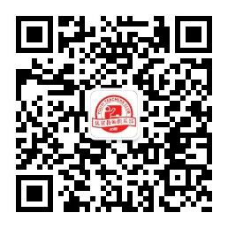
优质教学资源合集
优翼与一线教师联合编写，为各位老师提供优质的原创资源，内含教学课件、教案、配套习题课件、原创模拟卷、课文朗读音视频等资料。
实时更新！
扫码关注！
原创

Slide 2

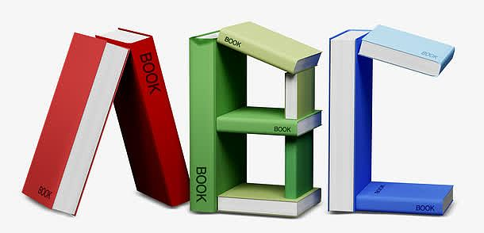
优翼英语教学课件（RJ）
八年级（上）

Slide 3

学习目标
Key words & phrases:
talent, have...in common, magician, all kinds of, beautifully, be up to,
role, play a role, winner, prize, make up, for example, poor, seriously,
take...seriously, give.
Key sentences:
1. Who is the most talented person you know?
2. It's always interesting to watch other people show their talents.
3. When people watch the show, they usually play a role in deciding
the winner.
To read the passage about talent shows.

Slide 4

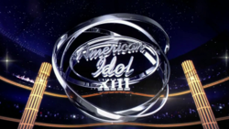


Lead in
Have you watched these talent shows?
What do you think of them?
American Idol
America's Got Talent
Britain’s Got Talent

Slide 5


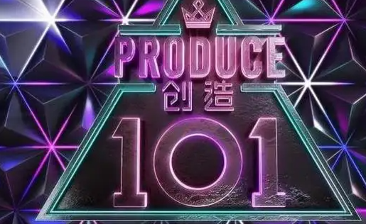
There are also many talent shows in China. Have you watched these following shows?

Slide 6
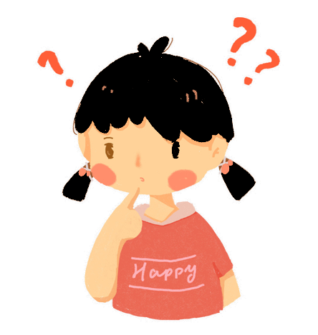
Discussion
Do you think those people who participate in theses shows are really talented?
Do you believe what they say in the shows?
Do you think we should take these shows seriously or just watch them for fun?

Slide 7
Pre-reading
Who’s the most talented person you know? What can he / she do? Tell your partner about this person.
2a
A: I think … is the most talented person.
B: What can he / she do ?
A: He / she …

Slide 8
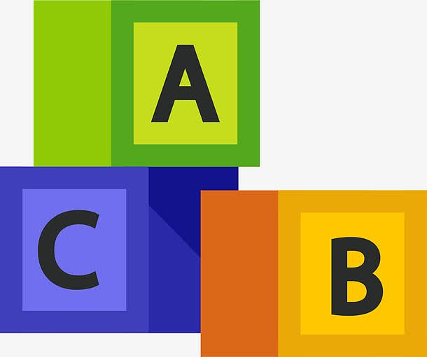
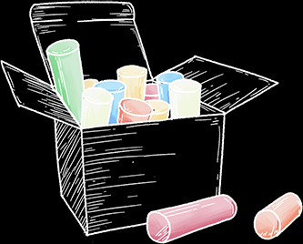
Unit 4 What’s the best movie theater?
Section B (2a-2e)

Slide 9
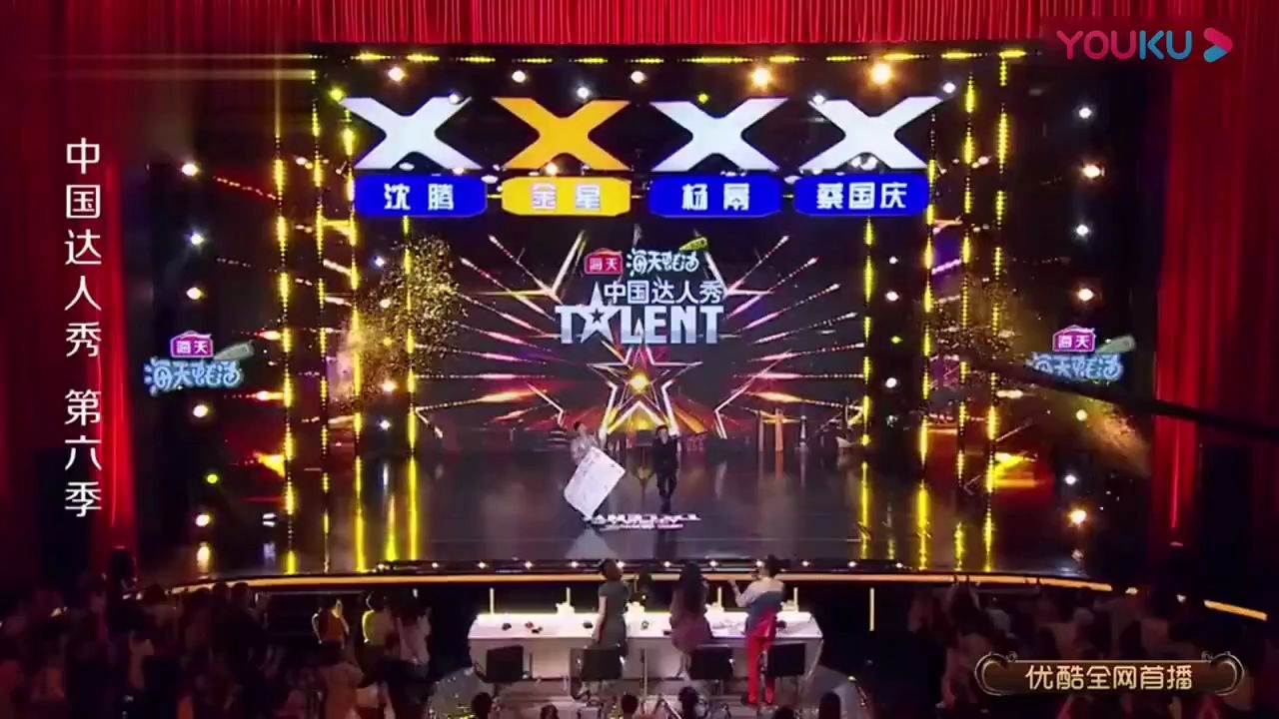
Lead in
1.What’s this TV show?
China’s Got Talent.
2. What do people do on the stage(舞台)？
They show their talents.
3. What do the audiences(观众) do？
They watch talented people show
their talents.

Slide 10

While-reading
skimming and matching
Skim the article and match each paragraph with the main ideas.
a. Different ideas about talent shows.
Para .1
b. Talent shows are getting more and
more popular.
Para. 2
Para. 3
c. Talent shows’ common features(特点).

Slide 11
scanning and answering
1.Which three talent shows are mentioned(提及)?
American Idol 美国偶像
American's Got Talent 美国达人秀
China's Got talent 中国达人秀
Para .1
2. How are talent shows getting now?
They are getting more and more popular.

Slide 12
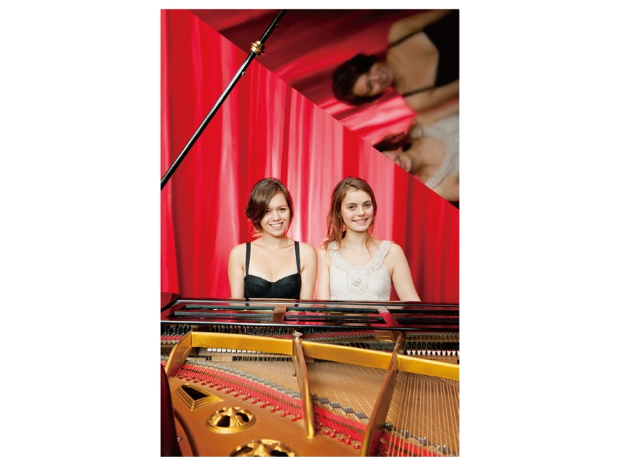
Presentation
2b
Paragraph 1
Who’s Got Talent?
Everyone is good at something, but some people are truly talented. It’s always interesting to watch other people show their talents. Talent shows are getting more and more popular. First, there were shows like American Idol and American’s Got Talent. Now, there are similar shows around the world, such as China's Got Talent.

Slide 13
Review the phrases.
have … in common
1. 有相同特征 _______________________
2. 各种各样的 _______________________
3. 由……决定 _______________________
4. 发挥作用 _______________________
all kinds of
be up to
play a role
make up
5. 编造 _______________________
6. 例如 _______________________
7. 认真对待 _______________________
8. 给某人某物 _______________________
for example
take … seriously
give sb. sth. / give sth. to sb.

Slide 14
2c
Read the paragraph 2 and answer the questions.
What do talent shows have in common?
________________________________________
________________________________________
________________________________________
2. Who decides the winner?
__________________________________________
They try to look for the best singers, the most talented dancers, the most exciting magicians, the funniest actors and so on.All kinds of people join these shows.
People who watch the show decide the winner.
( That’s up to you to decide. When people watch the show, they usually play a role in deciding the winner.)

Slide 15
Paragraph 2
All these shows have one thing in common: They try to look for the best singers, the most talented dancers, the most exciting magicians, the funniest actors and so on. All kinds of people join these shows. But who can play the piano the best or sing the most beautifully? That’s up to you to decide. When people watch the show, they usually play a role in deciding the winner. And the winner always gets a very good prize.

Slide 16
2c
Read the paragraph 3 and answer the questions.
3. Why do some people not like these shows?
________________________________________
________________________________________
4. Why do some people like these shows?
________________________________________
________________________________________
5. What do you think of these shows?(开放题)(观点可同3/4)
________________________________________
Because they think that the lives of the
performers are made up.
Because these shows are fun to watch and give people a way to make people’s dreams come true.
They are fun to watch.

Slide 17
Paragraph 3
However, not everybody enjoys watching these shows. Some think that the lives of the performers are made up. For example, some people say they are poor farmers, but in fact they are just actors. However, if you don’t take these shows too seriously, they are fun to watch. And one great thing about them is that they give people a way to make their dreams come true.

Slide 18
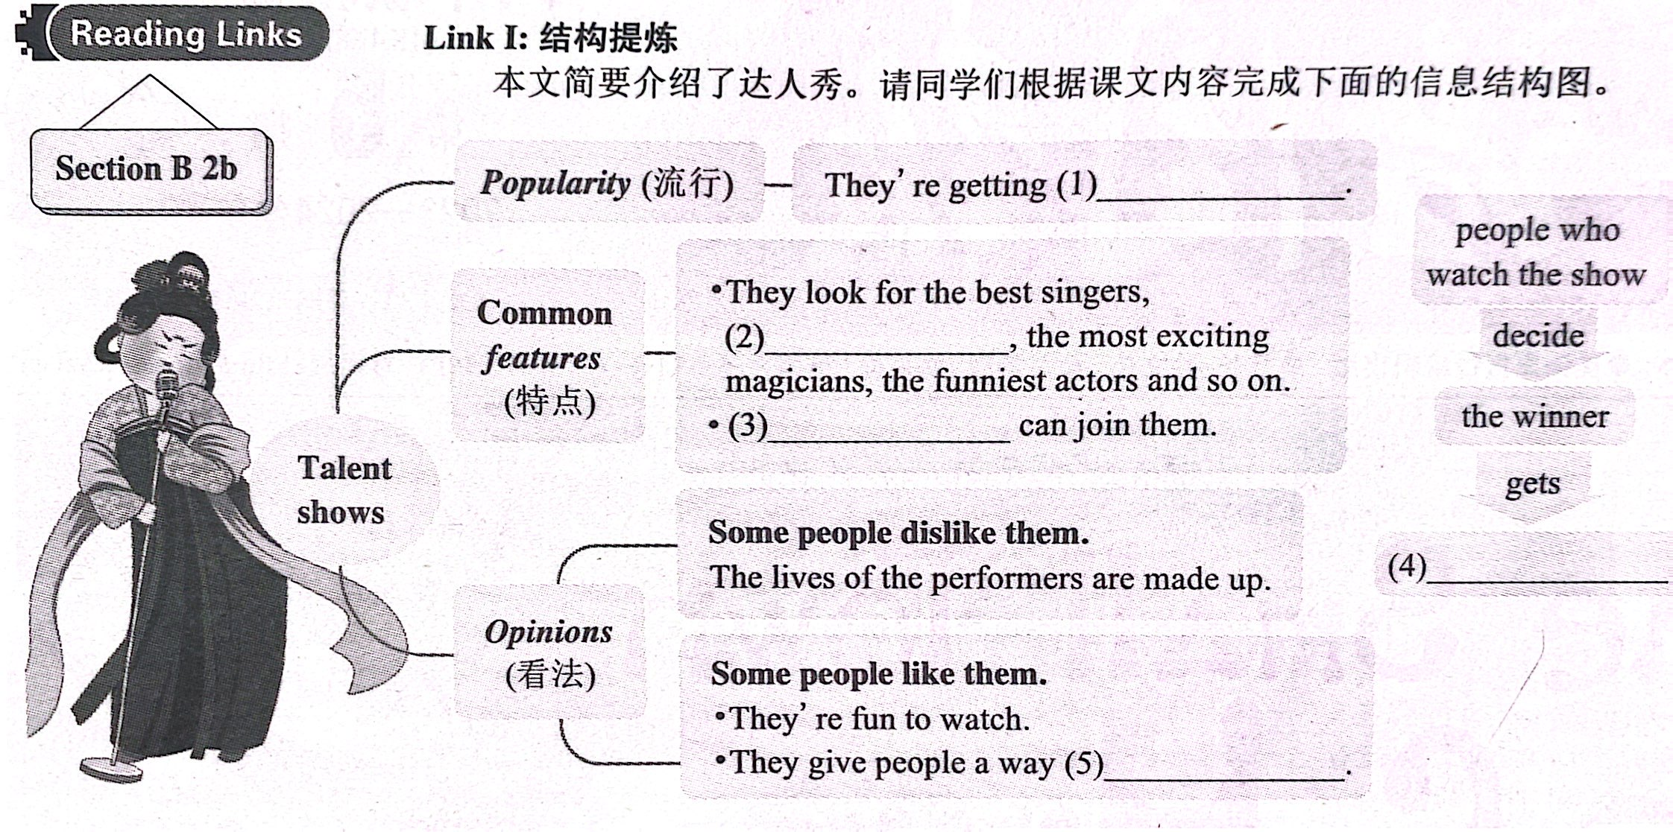
Retell the passage
more and more popular
the most talented dancers
All kinds of people
a very good prize
to make their dreams come true

Slide 19
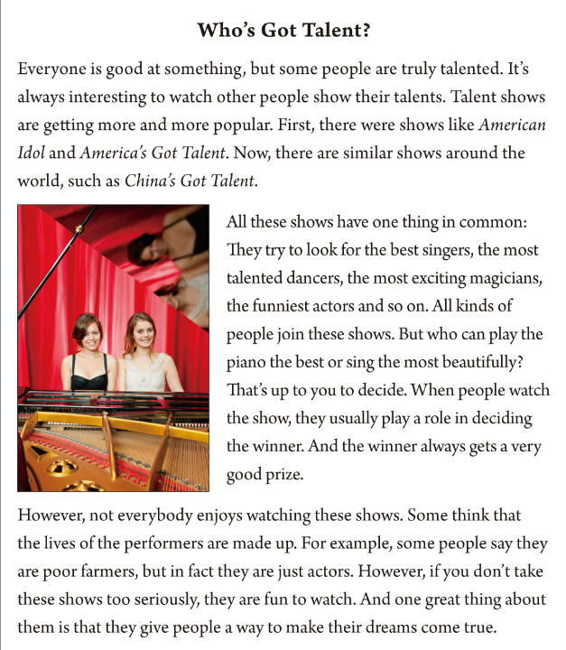
2d
Underline all the superlatives
in the passage. Then write
sentences using at least
four of them.
best singer: In my class, Tom is the
best singer because he can sing fast songs
very well.

Slide 20

most talented:
Jay Zhou is the most talented singer because he created many songs.
most exciting:
Jack is the most exciting magician in this school talent show, because he made a rabbit disappear（消失）.
funniest:
Shenteng is the funniest actor because his roles always make people laugh.
most beautifully:
Langlang plays the piano most beautifully because he is good at it.

Slide 22
2.Who decides the winner ?
1. What do the shows have in common？
the best singers
They try to
look for
the most talented dancers
the most
talented people.
Para. 2
the most exciting magicians
the funniest actors
People who watch the shows decide the winner.

Slide 23
Para. 3
 | reasons
People like talent shows.
People don’t like talent shows.
fun to watch
1.They are ____________ .
2. They give people a way____________________________.
to make their dreams come true
some people think that the lives of the performers ___________.
are made up

Slide 24
Task 3 mind-mapping
Some people like talents shows
because they are(5) _________
and they give people a way to
(6)_______________________ .
How
fun to watch
Talent shows are becoming
(1)____________________.
more and more popular
make their dreams come true
What
Why
talent shows
look for
They try to (2)_______
____________________.
the most talented people
Some people don't like talents shows because they think (4)___________________ _____________________.
the lives of some
performers are made up
Who
Why not
The people who watch the shows
(3)__________________________
decide the winner.

Slide 25
Talent shows are getting _____ ___ _____ __________.
more
and
more
popular
Summary
look
for
They try to ______ ______ the best performers.
Who’s Got Talent?
The shows have something ___ ________.
The audiences usually play a role in _________ ____ _________.
in
common
deciding
the
winner
get
a
very
The winners always _____ ___ ______ ________ _______.
good
prize
life
Some think that the ______ of the performers are _______ ______.
made
up
____ __________ enjoys watching these shows.
Not
everybody
take
If you don’t ______ these shows too __________,they are _____ to watch.
seriously
fun
The shows give people a way to _____ their dreams _______ ________.
make
come
true

Slide 26
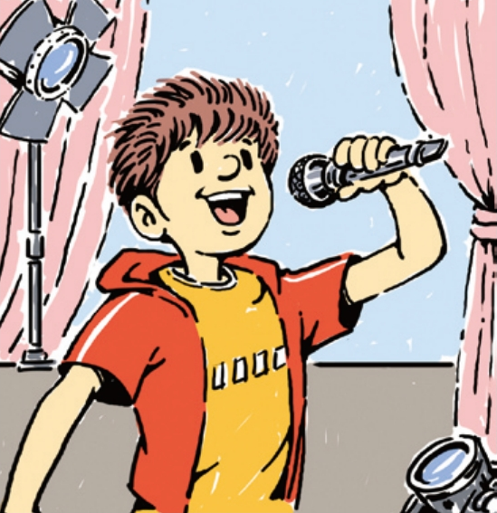
2d
Underline all the superlatives in the passage. Then write sentences using at least four of them.
______________________________________________________________________________________________________________________________________________________________________________________________________________________________________________
best singer: In my class, Tom is the best singer because he can sing fast songs very well.

Slide 27
Pair Work
A: Who (do you think) is the funniest person you know?
B: I think … is the funniest person I know.
A: Why do you think so?
B: Because ….
funniest most creative
best quietest
smartest tallest
heaviest friendliest
thinnest busiest
most popular ...

Slide 28
Post-reading
Who’s got talent in your class? Add more talents and write a classmate's name for each talent. Find out how many students in your group agree with you.
2e
Talents | Classmates' names | How many students agree?
the best chess player
the most talented dancer
the most interesting writer
the fastest runner

Slide 29
Language points
Who’s Got Talents? 谁是达人？
此句中who’s为who has的缩写。have got表示“具有；具备之意，相当于have。此句字面上的意思是“谁有才华？”如：
► Have you got time? I’ve got something important to tell you.
你现在有空吗？我有重要的事要告诉你。
► We’ve got a lot of work to do, you see, to make our town
more beautiful. 你们瞧，要把我们的城市变得更加美丽
的话，我们是有很多工作要做的。

Slide 30
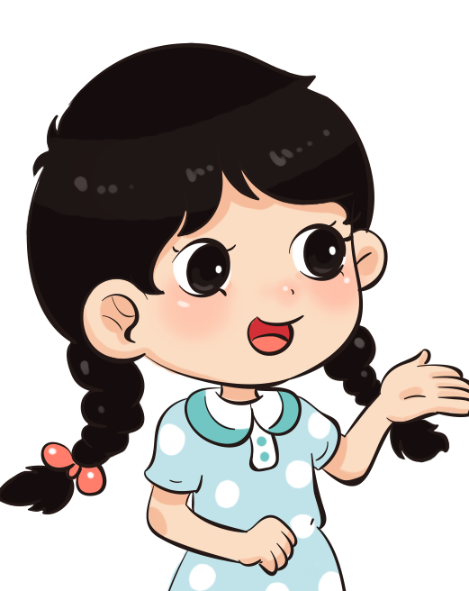
2. It’s always interesting to watch other people show their talents.
watch sb. do sth. 看到某人做某事
watch sb. do sth. | “看到某人做某事”，强调看到某个动作经常发生或看到某人做某事的全过程。 | I watched him go, and then I went home.
watch sb. doing sth. | “看到某人正在做某事”，强调看到某个动作正在进行。 | I watched him playing football as I passed by.
接不带to的不定式作宾语补足语的动词
两眼(see, watch) 一耳(hear) 一 注意(notice)，加上三个小使役( have, make, let)，半个help莫忘记。

Slide 31
3. Talent shows are getting more and more popular.
more and more+形容词/副词原级
“more and more+形容词/副词原级”表示“越来越……”，此处指的是多音节或部分双音节形容词或副词。单音节或部分双音节形容词或副词在表示“越来越……”时，用”比较级+and+比较级“结构。
Sam works more and more carefully.
The weather is getting hotter and hotter.
拓展延伸：“more and more+名词” 表示“越来越多的……”
More and more foreign students begin to learn Chinese.

Slide 32
4. All these shows have one thing in common...
have...in common 有相同特征；（想法、兴趣等方面）相同
该短语中have后可用much, nothing, a lot等词或短语作宾语。
The two games have nothing in common.
Generally speaking, excellent learners have some good habits in common.

Slide 33
5. That’s up to you to decide. 那由你自己来决定。
在英语中，be up to somebody是一个习惯用语，用来表“由某人做出抉择”，句子的主语通常为it，有时也用this或that。如：
► You can join the club once or twice a week — it’s up to you.
你可以一周参加一次或两次俱乐部的活动—这由你定。

Slide 34
► How much should he pay? That’s up to him to decide!
他应该付多少钱？那完全由他来决定。
► It will be up to you to decide which one you want to use.
这取决于你想用哪个。
► I can tell you that the question will come up, but the
outcome will be up to you.
我只能够告诉你这个问题将出现，而结果如何取决于你。

Slide 35
6. When people watch the show, they usually play a role in deciding the winner.
play a role 是一种固定表达， 意为“扮演某一角色；起到某种作用”。若要进一步引出具体的内容，后面应该用介词in，表示“在某事或某个方面起到作用或承担某种角色”。
► John is playing the leading role in this year’s play.
今年的演出中约翰是主角。
► Schools play the most important role in education.
学校在教育中起着最为重要的作用。

Slide 36
7. Some think that the lives of the performers are made up.
make up 编造（故事、谎言等）
make up意为“编造（故事、谎言等）”。此处are made up为被动语态结构，意为“被编造”。
Your task is to draw a picture. Ours is to make up a story.
拓展延伸：make up 的其他含义
和解
Did you make up with your friend?
make up
组成
We need one more player to make up a soccer team.
化妆
She spent too much time making herself up.

Slide 37
8. However, if you don’t take these shows too seriously, they are fun to watch.
take在此处有consider (认为；觉得)的意思。take someone/something seriously就相当于汉语“认真对待某人或某事；把某人或某事当真”的意思。如：
► He was joking, but your sister took him seriously.
他是在开玩笑，但你姐姐却当真了。

Slide 38
有时老师们把学生作业看得太重。
Sometimes teachers take students’ homework too seriously.
人家托你的事，你别不在意。
When people ask you to do something, you should take it seriously.

Slide 39
I. 单项选择
Exercises
1.—Another person was hurt by the tiger in the zoo.
—What a pity! That is a lesson to us, we must take rules ______.
A. quickly B. clearly C. carefully D. seriously
D
D
2.The teacher asked the students to ______ a story about a trip to the moon.
A. give up B. turn up C. cut up D. make up

Slide 40
3.As long as all the Chinese people pull together(齐心协力), our China Dream will ______.
A. come true B. come out C. come up D. come down
A
4.—Our neighborhood is so dirty. Shall we clean it this afternoon or tomorrow?
— ______. Any time is OK.
A. It’s up to you B. Excuse me
C. Have a good time D. I'm afraid I can't
A
D
5.—Although they are twins, they have nothing ______ common.
—I think they look the same.
A. at B. with C. on D. in

Slide 41
Ⅱ.用所给单词的适当形式填空
magician
1.I want to be a famous ___________ (magic). Performing magic tricks is good fun.
2.The _________ (win) of this year's Young Star Award is...Daniel! Well done!
3.We shouldn't take these game shows too ________ (serious) while watching them.
4.I think Joe's song was the _______ (bad) of all. I don't like it at all.
5.Everybody _______ (like) this talent show. It's really wonderful.
winner
seriously
worst
likes

Slide 42
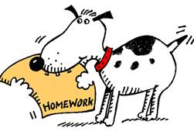
Homework
1. Preview the new words and phrases in
Section B (3a-Self Check).
2. Do the exercises in students’ book.

Slide 43

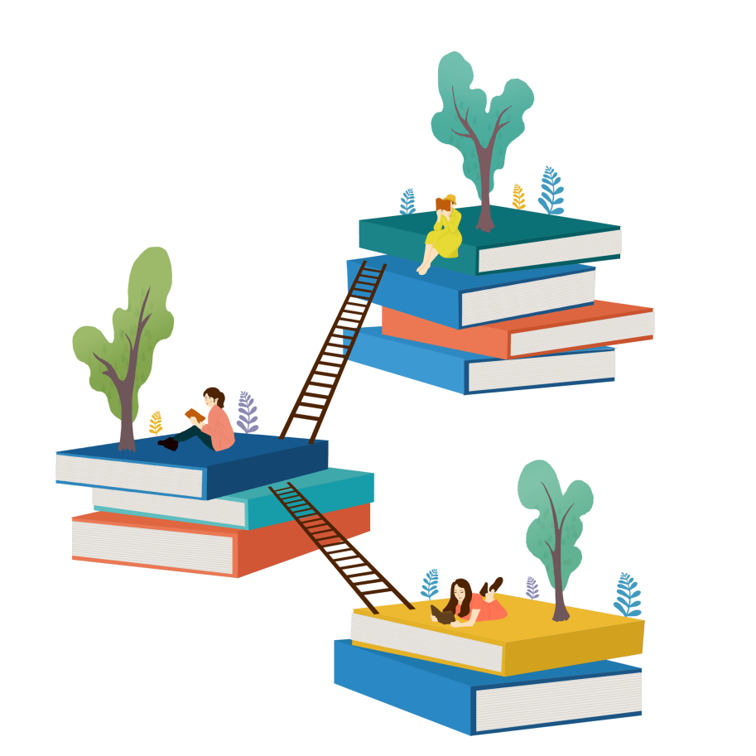

Slide 44
声 明
本文件著作权为创作公司所有, 仅限于教师教学及其他非商业性和非盈利性用途。如发现盗用、转卖、网络传播等侵权行为, 本公司将依法追究其相应法律责任。
部分素材选自网络, 如有争议, 请联系删改。

